Slide 1




Process Flow Under TPA
Medical Reimbursement
&
Special Medical sanction
23-Aug-2025
touching lives, spreading smiles…

Slide 2
Retired Employee MRC Process (Outdoor)– Step by Step
Submission by User – Step 1 :
  Beneficiary Creates claim in Bandhan (option 1) or submits in old claim form (option 2)
  TPA – punches the claim details and creates it.
  Note: Submit Hard copies and printout to TPA helpdesk. (No option available to upload the scanned documents in bandhan)
  Screen Example: Enter details like CPF Number, Treatment Type (Outdoor), Claim Month/Year.
touching lives, spreading smiles…

Slide 3
Retired Employee MRC Process – Step by Step
TPA Processing – Step 2 :
  Claim data sent to TPA.
  TPA team at backend reviews documents and recommends amount
  (e.g., deductions if any, with comments).
  Data flows back to SAP.
Level 1 Approval (ONGC HR Team)
  Approver views claim; recommended amount is frozen (cannot change).
  TPA comments visible (e.g., reasons for reductions).
  Click ‘Forward’ to send to Level 2.
Level 2 Approval (ONGC HR Team)
  Similar view; amount non-editable.
  Approve the claim → Payment record generated automatically.
User can track claim status via Bandhan, by employee login in ongc.mdindianetworx.com or contact TPA helpdesk.
touching lives, spreading smiles…

Slide 4
Retired -Other Medical Sanction - Overview
For special claims requiring approvals (e.g., beyond standard limits)
Nursing/ Attendant Care
Physiotherapy
Life Saving Devices
Hearing Aid
Artificial Appliances
Flowchart:
Presently - SEE DO initiates claim in Disha for approval.
Process Flow – No TPA Role
Based on the recommendation of domain expert - ONGC Doctor – AA & ES is obtained.
SEE DO submits claim in SAP on behalf of separated employee section by attaching the copy of Disha approval.
SEE Head approves in SAP.
Payment record created.
touching lives, spreading smiles…

Slide 5
Retired Employee Special Medical Sanction Process (SMS/Indoor claims)
Flowchart :
TPA submits claim in SAP
Claim data sent to TPA backend team
TPA processes and sends back recommended amount.
Claim appears in SAP for SEE DO (Separated Establishment Dealing Officer).
Disha file initiated for approvals.
SEE DO forwards claim in SAP (after Disha approvals).
SEE Head approves in SAP.
Payment record created.
touching lives, spreading smiles…

Slide 6
FAQ – Frequently asked questions
Q: Can I submit claims without TPA?
A: No, TPA processing is mandatory in TPA-based locations.
Q: What if my claim amount is reduced?
A: TPA provides comments; contact them for clarification.
Q: How long does processing take?
A: Depends on TPA review and approvals; aim for timely submissions.
Q: Do I need attachments in the system?
A: No longer mandatory digitally, but physical docs are required at TPA.
Q: Who to contact for issues related to Medical Reimbursement?
A: TPA helpdesk.
touching lives, spreading smiles…

Slide 7
Contact Information
Contacts:
TPA Helpdesk: [ongc.helpdesk@mdindianetworx.com /8956750117]
MDIndia Healthcare Networx Pvt. Ltd.
c/o – Separated Employee Section,
ONGC, 6th Floor, Core 4,
SCOPE Minar, Laxmi Nagar,
New Delhi
Email Address: ongc.helpdesk@mdindianetworx.com
Landline :
Toll Free: 1800-267-9960
Visit us @ www.mdindiaonline.com
Separated Establishment Section: [seedelhi@ongc.co.in/011-22406513, 6615, 6668, 6665, 6617, ]
System Support (Bandhan/SAP): [editorspeak@ongc.co.in]
touching lives, spreading smiles…

Slide 8
To view the status of submitted Medical claims:
Login to the URL :
https://ongc.mdindianetworx.com/
Click on Employee
Enter your CPF Number and Captcha
Enter OTP (received on registered mobile number)
Check status of submitted claims
touching lives, spreading smiles…

Slide 9
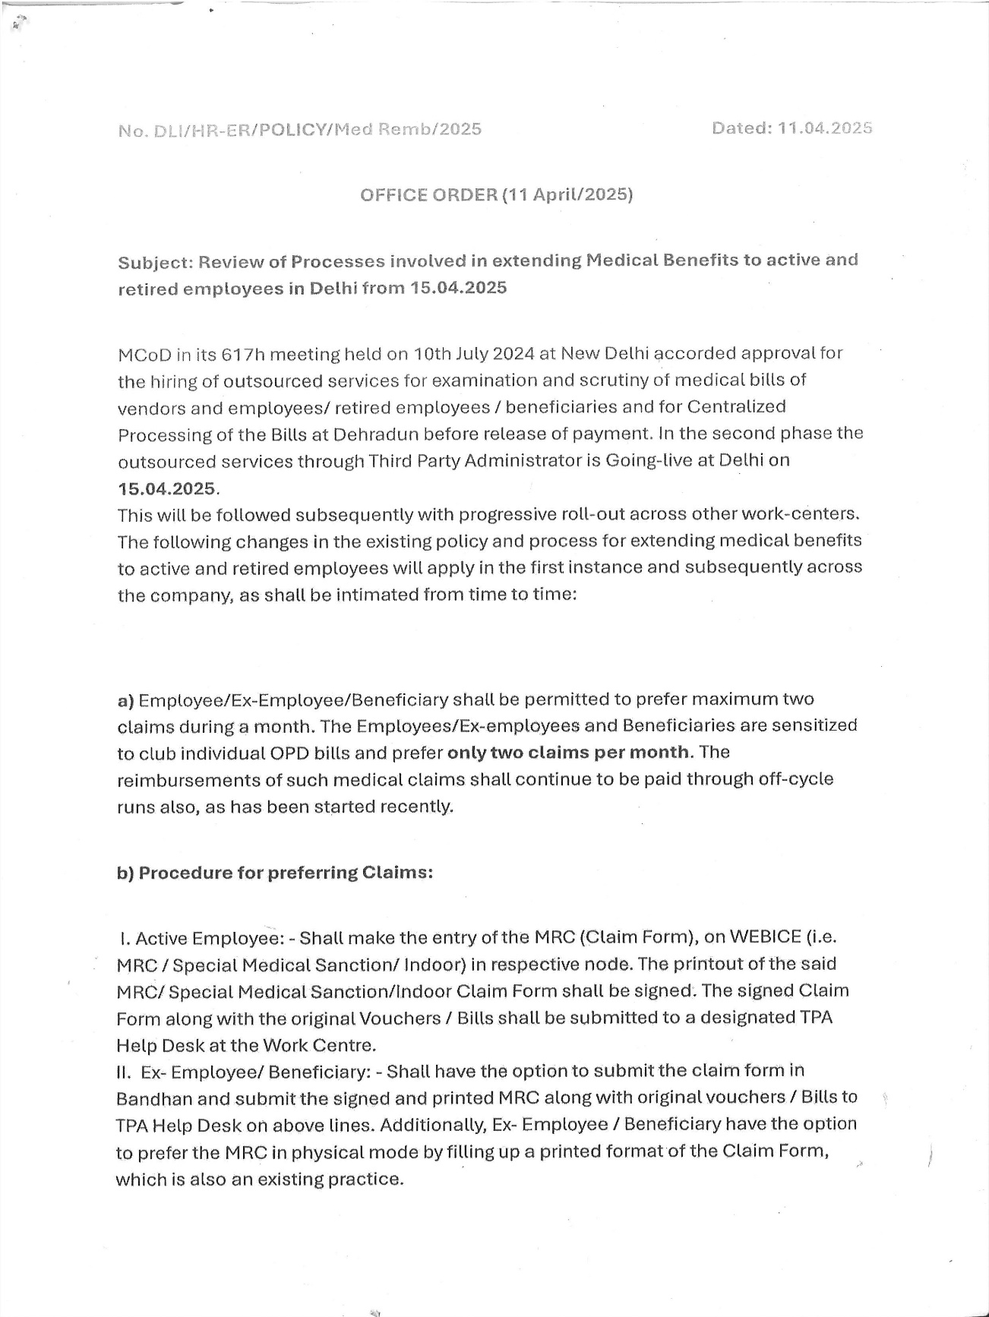
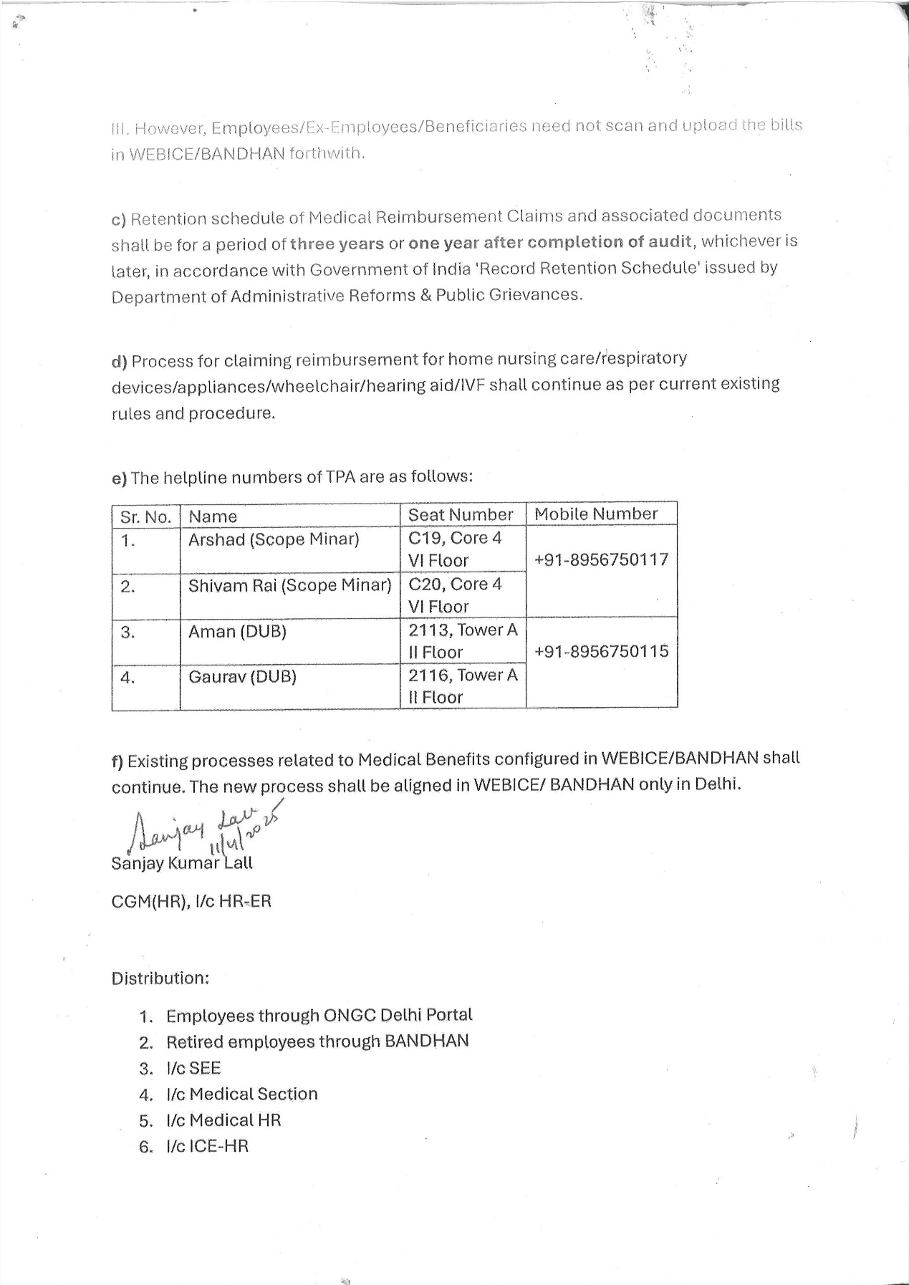
Display of Bandhan
touching lives, spreading smiles…

Slide 10
Thank You

